Slide 1
Set Theory and Broadening and Narrowing
Samuel Johnson Ontiveros

Slide 2
Research questions
Does Set Theory explain broadening and narrowing consistently?
Is there a consistent pattern of broadening from Latin to Romance?

Slide 3
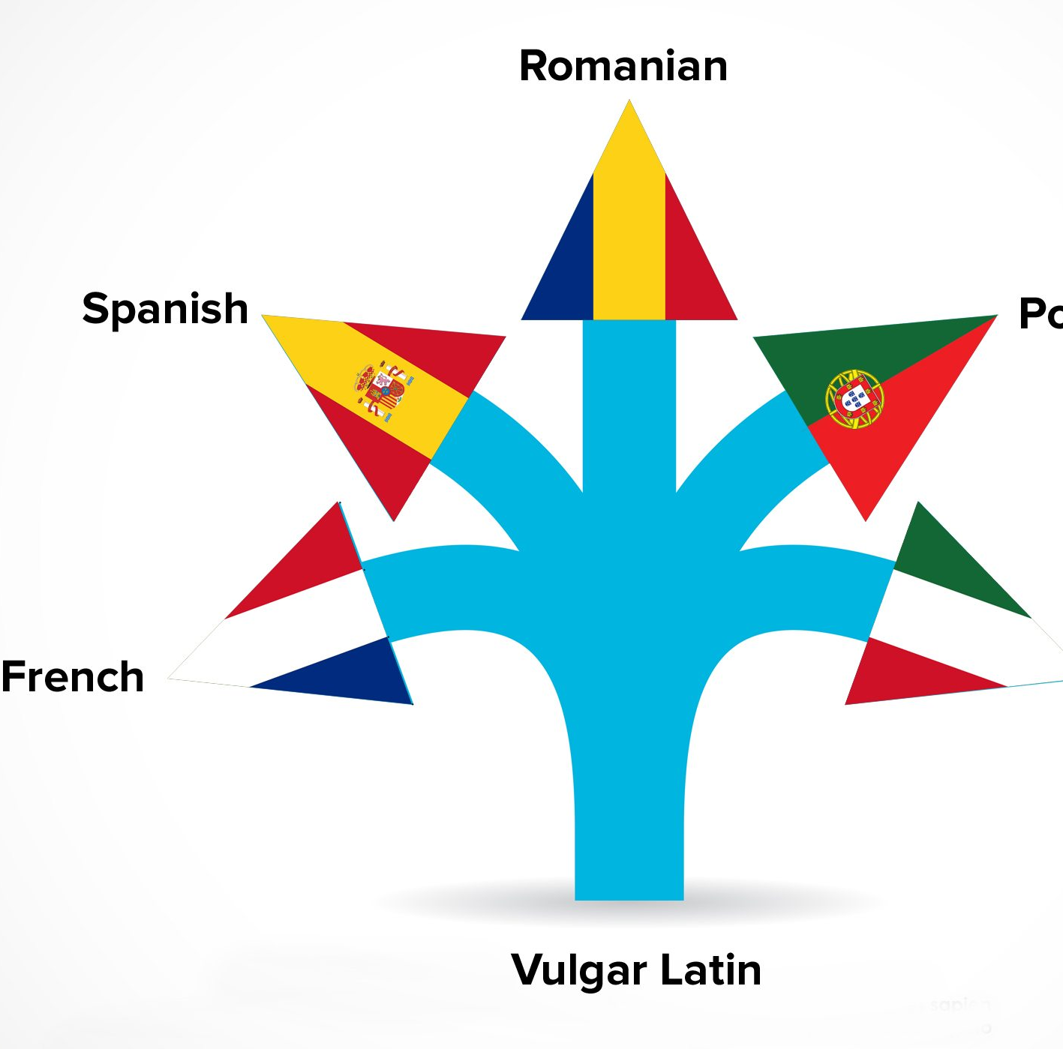
What is Romance?
Romance refers to the dialects of Vulgar Latin that are now collectively referred to as the Romance Languages, hence the Roman in romance.

Slide 4
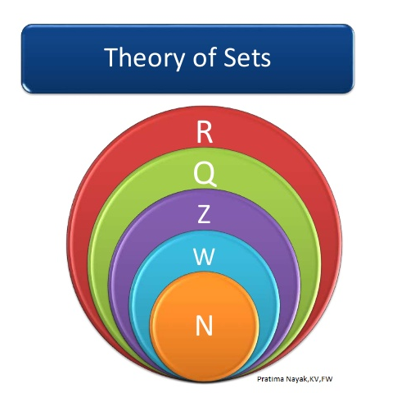
What is Set Theory Bezhanishvili, G., & Landreth, E. (2013

Slide 5
According to Georg " we are to understand any collection into a whole M of definite and separate objects m of our intuition or our thought. These objects are called the elements" of M.

Slide 6
Important logical operators to understand
X and y
X in y
X not in y

Slide 7
Methodology
Step 1. Define the meanings of cognates in Latin and Romance
Step 2. Separate those meanings and assign them variables.
Step 3. Apply those variables to a Set, labelled as the capital letter of the word in Romance.
Step 4. Use the logical formalization of Set Theory .

Slide 8
Broadening

Slide 9
An example using FABVLARE/
PARABOLARE
X= Narration

Slide 10
Using Focus, x = Center of the House

Slide 11
Using Avunculus, for Fr,
x = Father's brother

Slide 12
Using Casa, for Span and Port

Slide 13
Narrowing

Slide 14
Using Auca, x= "gooseness"

Slide 15
Using Rezar, for Spanish and Portuguese x = prayer

Slide 16
While still too early for conclusions
Set Theory does appear to lend well to the explanation of words as being compromised of semantic members
Seems to be consistent in single languages but throughout Romance requires more research

Slide 17
Gracias, Merci, et Obrigado for attending my presentation

Slide 18
Bibliography
Bezhanishvili, G., & Landreth, E. (2013). An introduction to elementary set theory. Convergence.
Вlank, A., & Koch, P. (1999). Onomasiologie et Étymologie Cognitive: L'exemple de la tête.
Caput, J. P. (1986). L'Académie française. FeniXX.
Chomsky, N. (2002). Syntactic structures. Walter de Gruyter.
Contreras, J. C. (2001). ESTUDIO ONOMASIOLÓGICO DE LAS PARTES DEL CUERPO latín, español medieval y francés medieval. Analecta Malacitana (AnMal electrónica), (9), 2.
De Swart, H. (1998). Introduction to natural language semantics.
Diez, F. C., & Donkin, T. C. (1864). An Etymological Dictionary of the Romance Languages; chiefly from the German of F. Diez. By TC Donkin. Williams and Norgate. https://books.google.com/books?hl=es&lr=&id=5uTYyRhLl0kC&oi=fnd&pg=PA1&dq=Etymological+dictionary+of+romance&ots=8SAwDQ4ZW2&sig=QORf-LgYd3kC0JZS28rT3ECMkP8#v=onepage&q=Machoire&f=false
Herman, J. (2000). Vulgar latin. Penn State Press.
Ørberg, H. H. (2002). Lingua Latina per se illustrata (Vol. 2). Museum Tusculanum Press.
Partee, B. B., ter Meulen, A. G., & Wall, R. (2012). Mathematical methods in linguistics (Vol. 30). Springer Science & Business Media.
Resnick, M. C., & Hammond, R. M. (2019). Introducción a la historia de la lengua española: segunda edición. Georgetown University Press.
Schweickard, W. (2013). Ti Alkire/Carol Rosen, Romance Languages. A Historical Introduction, Cambridge et al., Cambridge University Press, 2010, IX+ 377 p. Zeitschrift für romanische Philologie, 129(4), 1211-1212.
Tornatore, M. G. (2006). In defense of an endangered species: Historical Romance linguistics. Romance Notes, 46(2), 243-252.
Wright, R. (2018). Studying Ibero-Romance before 1200. Studies in Historical Ibero-Romance Morpho-Syntax, 16, 325.
Wright, R. (2019). Homonymy and suppletion in the history of Spanish traer,'to bring'. In Estudios lingüísticos en homenaje a Emilio Ridruejo [2 vol.] (pp. 1409-1416). Universitat de València.
Elmarin

